Slide 1
Introduction to
Security Testing

Slide 2
Agenda
What is Security Testing?
Why should a QA think about security aspects!
Exploring Defense Mechanisms
Q&A
10.136.125.131:3000

Slide 3
What is Security Testing?
Notes:
Prime objective of security testing is to find out how vulnerable a system may be and to determine whether its data and resources are protected from potential intruders
As the number of digital invaders grow, it is undeniable that a security-breach is not a question of if, rather a question of when
Studies suggest that security should, in fact, be made a business priority, as businesses of the day are running the show predominantly through digital platforms. Organizations, therefore, need to be able to invest in security, in order to guarantee products and services of utmost quality.
Security testing helps avoid:
Loss of customer trust
Inconsistent website performance
Additional costs required to repair website after an attack
Other legal implications that arise due to lax security measures

Slide 4
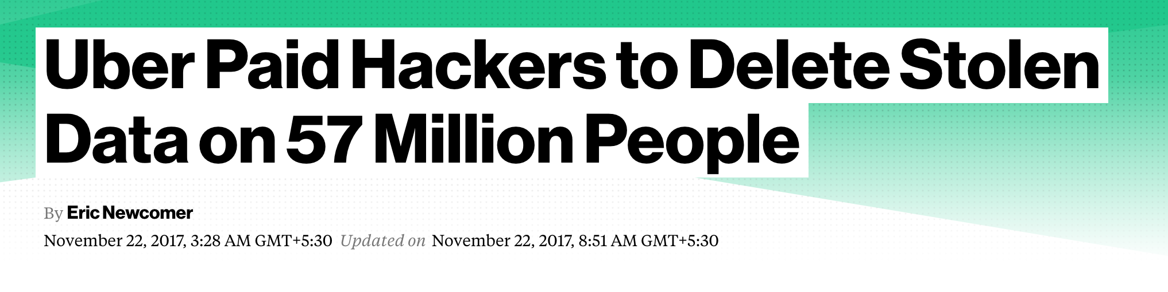
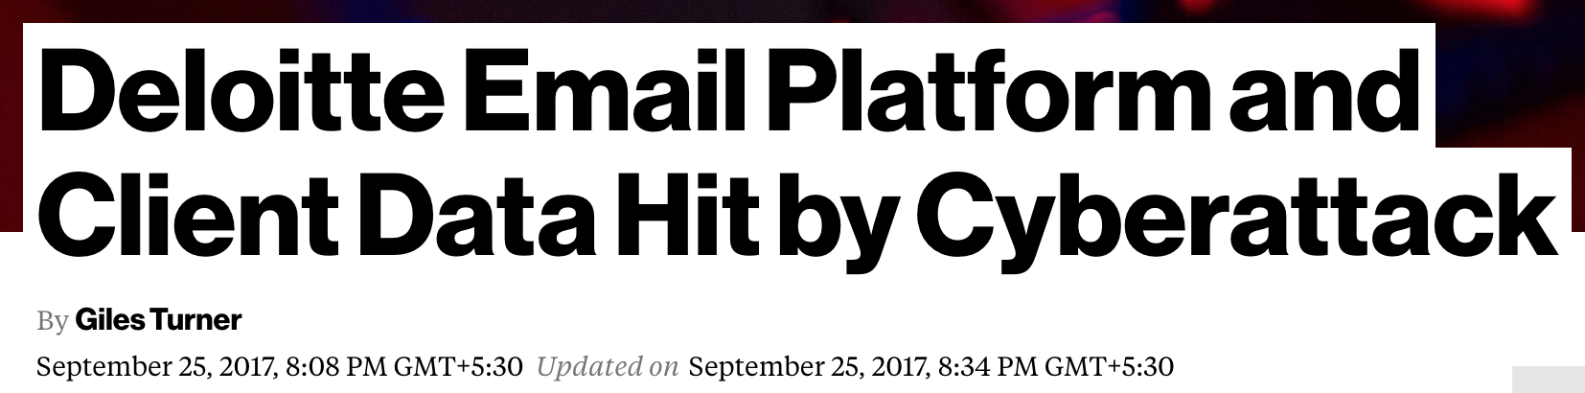
Recent Data/Security Breaches
GitHub a code repo was compromised.
Internal email server is compromised
Click here to explore more…..
Notes:
Uber → The most recent security breach, that affected close to 57 million users and drivers personal information and also costed about $100,000. What went wrong here?
GitHub a prominent dev code repo, had all the user data recorded without proper security measures, which led to the hack.
According to Bloomberg, the breach occured when two hackers obtained login credentials to access data stored on Uber’s Amazon Web Services account.
Deloitte → Do we have any participants from Deloitte to share details on this hack?
A giant accountancy firm, that had an explicit security team was not spared either. To shed some light on that breach, it occured because the administrator account credentials were compromised, giving access to their email server.
let hackers access data from an internal email platform.
The hacker compromised the firm’s global email server through an “administrator’s account” that, in theory, gave them privileged, unrestricted “access to all areas”.
The account required only a single password and did not have “two-step“ verification, sources said.
Let us now quickly go through some of the World's Biggest Data Breaches
Rivercity media:Revealed by MacKeeper Security Researcher, Chris Vickery in cooperation with CSO Online and Spamhaus, the researchers“stumbled upon a suspicious, yet publicly exposed, collection of files. Someone had forgotten to put a password on this repository and, as a result, one of the biggest spam empires is now falling.”
https://www.theverge.com/2017/8/31/16232144/onliner-largest-malware-spambot
FriendFinder messed up in a few ways. For one, the company either stored user passwords in plaintext, without any protection, or hashed them using the notoriously weak SHA1 algorithm, according to LeakedSource. The company also kept logins for a site they don’t even run anymore (FriendFinder sold Penthouse.com to Penthouse Global Media in February). FriendFinder also retained email and passwords for over 15 million people who had deleted their accounts.

Slide 5


A Recent Survey Indicates….
@Cisco’s 2017 study found that 20% of breached orgs lost customers, with 40% of them losing more than 20% of their customer base….
Notes:
According to Cisco’s 2017 Annual Cybersecurity Report, over 33% of the organizations all over the globe had to deal with a cyber-breach in 2016. This resulted in a severe loss of users, business opportunities and overall revenue by a whopping 20%. The report surveyed nearly 3,000 chief security officers (CSOs) and security operations leaders from 13 countries.

Slide 6

Are you wondering why should a QA think about security aspects?
Notes:
QA understands the way an application is put together, and their perspective can be invaluable when determining areas at risk
The holistic thinking process allows them to see the big picture, a necessary part of tackling the persistent problems within the software development industry.
Our job is to help developers and business stakeholders specify security requirements with enough precision that they can be tested.
Quality and software security are not separate worlds, but rather two sides of the same coin—the bug that manifests as a system failure today could be a vulnerability exploited by an attacker tomorrow

Slide 7

How or where to begin?
Notes:
Think of this analogy of a building.
Consider the infrastructure of your home(servers, databases,operating systems) as a building infrastructure and the your important assets lying in the building.
How do you make sure that the assets are safe from any outsider?
Are your doors n windows closed?
Can they be broken?
If broken, is there an easy access to the assets etc
It is like the person that locks their front door but leaves every window unlatched and the alarm system turned off.

Slide 8
A breach can occur and affect any segment.
Web
Server
Framework
Application Server
Database
PRODUCT
Platform
Notes:
Web servers are one of the most targeted public faces of an organization, because of the sensitive data they usually host.-
Apache struts - deserialize untrusted data.
serialising - converting data to binary format
Web server things to take care: Remove unnecessary services, remote access, Install security patches on time,unused default user acount should be removed
Application server - Playstation hack - millions of users data is stolen.

Slide 9
Exploring Defense Mechanisms
Notes:
Prime objective of security testing is to find out how vulnerable a system may be and to determine whether its data and resources are protected from potential intruders
As the number of digital invaders grow, it is undeniable that a security-breach is not a question of if, rather a question of when
Studies suggest that security should, in fact, be made a business priority, as businesses of the day are running the show predominantly through digital platforms. Organizations, therefore, need to be able to invest in security, in order to guarantee products and services of utmost quality.
Security testing helps avoid:
Loss of customer trust
Inconsistent website performance
Additional costs required to repair website after an attack
Other legal implications that arise due to lax security measures

Slide 10
D
E
F
E
N
S
E
M
E
C
H
A
N
I
S
M
S
Authentication
Session Management
Authorization
Best Practices
Stay up-to-date
Data Protection
Notes:
Let us look at each of these classifications now in detail!

Slide 11
Authentication

Slide 12
Credentials should be transported via encrypted channels,
Strong password policy,
Don’t disclose too much information in error messages,
Account lockout against brute force attacks,
Don’t hard-code credentials,
Store credentials securely.
Notes:
It’s about verifying user’s identity
authentication is the process of attempting to verify the digital identity of the sender of a communication
ex: log on process
https://www.owasp.org/index.php/Testing_for_Credentials_Transported_over_an_Encrypted_Channel_(OTG-AUTHN-001)

Slide 13


Click to decode MD5 key
How to safeguard?
Click to decode Base64 key
Use Password Managers
Avoid using MD5 or Base64 Algorithms
Implement Two-factor Authentication
Explore and use Talisman or similar tools
Implement GitCrypt
Notes:
Password Managers help us manage our project passwords in an organized manner by enabling generation of strong passwords. It encrypts the password database with a master password – the master password is the only one you have to remember.
Two-factor authentication works as an extra step in the process, a second security layer, that will reconfirm your identity. Its purpose is to make attackers' life harder and reduce fraud risks.
Talisman is a tool to validate code changes that are to be pushed out of a local Git repository typically our workstation. By hooking into the pre-push hook provided by Git, it validates the outgoing changeset for things that look suspicious - such as potential SSH keys, authorization tokens, private keys etc.
Git Crypt enables transparent encryption and decryption of files in a git repository. Files which you choose to protect are encrypted when committed, and decrypted when checked out. git-crypt lets you freely share a repository containing a mix of public and private content.
git-crypt gracefully degrades, so developers without the secret key can still clone and commit to a repository with encrypted files. This lets you store your secret material (such as keys or passwords) in the same repository as your code, without requiring you to lock down your entire repository.
Algorithms to use:
strong algorithms like PBKDF2, bcrypt, or SHA-512.

Slide 14
Authorization
Notes:
Authorization is the concept of allowing access to resources only to those permitted to use them.
so the tester will verify this point after he holds valid credentials, associated with a well-defined set of roles and privileges. During this kind of assessment, it should be verified if it is possible to bypass the authorization schema, find a path traversal vulnerability, or find ways to escalate the privileges assigned to the tester.
Access confidential files:
Using web scanner like dirb

Slide 15

Information Access
Check unusual elevation of privileges(ACLs),
Apply the principle of least privileges,
Log all privilege changes,
Log administrative activities,
Log access to sensitive data.
Has the server been hacked!
Notes:
A network engineer at a company EnerVest committed data sabotage after learning he was going to be terminated.
The employee reset all network servers to factory default settings and disconnected remote backups
EnerVest was unable to conduct operations for 30 days and cost in excess of $1 million.

Slide 16
Data Protection

Slide 17
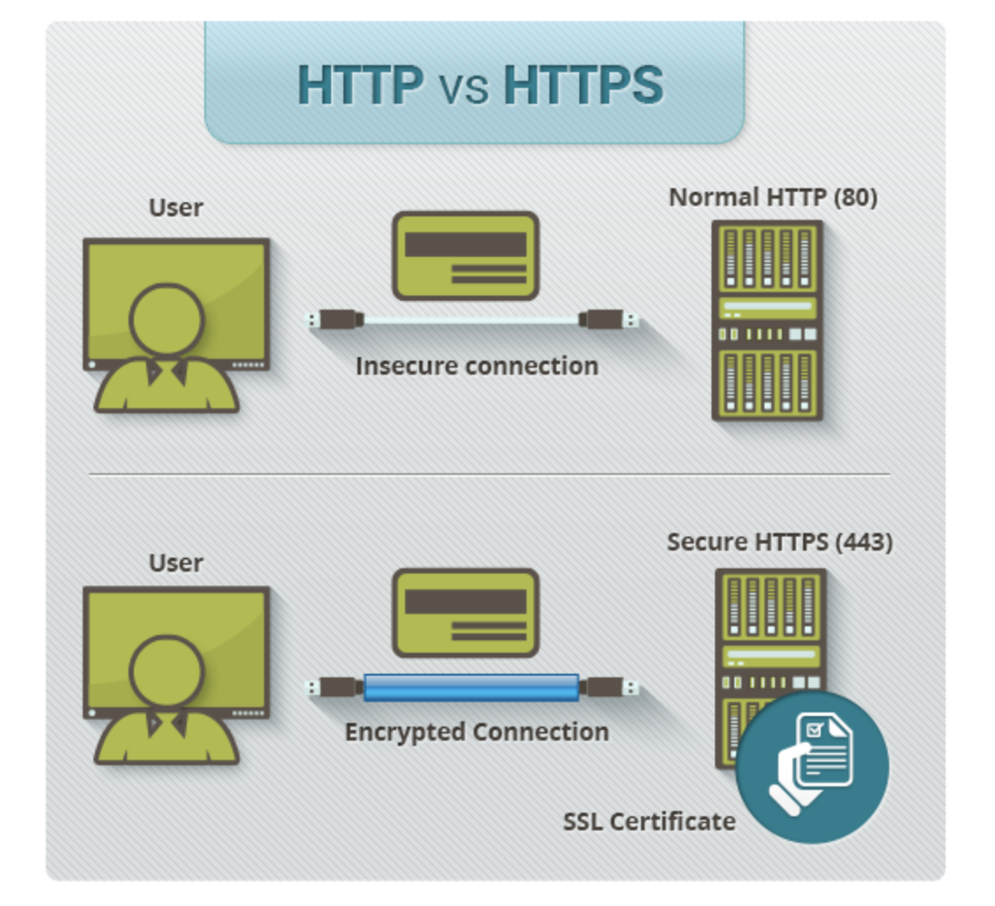
HTTPS provides multiple layers of protection to data as in:
encryption
data integrity
authentication
Notes:
In HTTPS, “S” stands for “SSL”, which stands for Secure Sockets Layer.
This is the technology that encrypts your connection to a website, so that hackers can’t intercept any data, like customer payment details or account login information.
encryption – the data is worthless to anyone who somehow manages to intercept it because they don’t have the key to decrypt it.
data integrity – data can’t be corrupted, which is a good thing.
authentication – it prevents “man in the middle” attacks and that is what SSL certificate does!
Authentication prevents Man in the middle: which means that it’s not possible for anyone to trick people into thinking they’re providing you data when they’re really giving it to a scammer.
Store user passwords using a strong ietrative salted hask - linkedin data leak

Slide 18
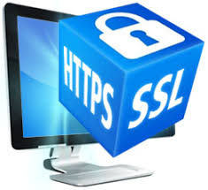
Choose HTTPS over HTTP
Store user passwords using a strong, iterative, salted hash
<script>alert("Hacked")</script>
`
Notes:
Store user passwords using a strong iterative salted hask - linkedin data leak

Slide 19
Input Validation
Notes:
Input validation is performed to ensure only properly formed data is entering the workflow in an information system, preventing malformed data from persisting in the database and triggering malfunction of various downstream components. Input validation should happen as early as possible in the data flow, preferably as soon as the data is received from the external party.
Xss:
on search field <script>alert(“Hacked”)</script>
place an order that makes you rich
On basket page : add quantity - intercept it and modify to a negative value.
checkout and see the total price
Data from all potentially untrusted sources should be subject to input validation, including not only Internet-facing web clients but also backend feeds over extranets, from suppliers, partners, vendors or regulators[1], each of which may be compromised on their own and start sending malformed data.

Slide 20
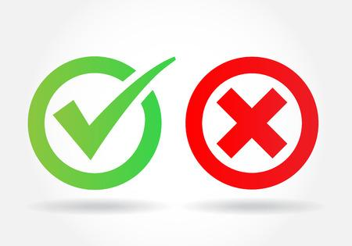
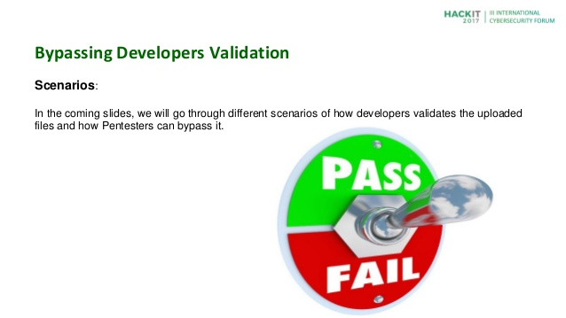
Prefer whilelists over blacklists
Whitelisting
Blacklisting
Validate uploaded files
Notes:
Advantages of Blacklisting
One of the principal advantages of blacklisting lies in the simplicity of its principle: You identify everything bad that you don’t want getting into or operating on your system, exclude it from access, then allow the free flow of everything else. It has been and continues to be the basis on which signature-based anti-virus and anti-malware software operates.
Advantages of Whitelisting
Whitelisting is also a valued option in corporate or industrial environments where working conditions and transactions may be subject to strict regulatory compliance regimes. Strict controls on access and execution are possible in environments where standards and policies need to be periodically reviewed for audit or compliance purposes.

Slide 21
Stay Up-to-date
Notes:
OpenSSL cryptographic software library has a memory leak bug

Slide 22
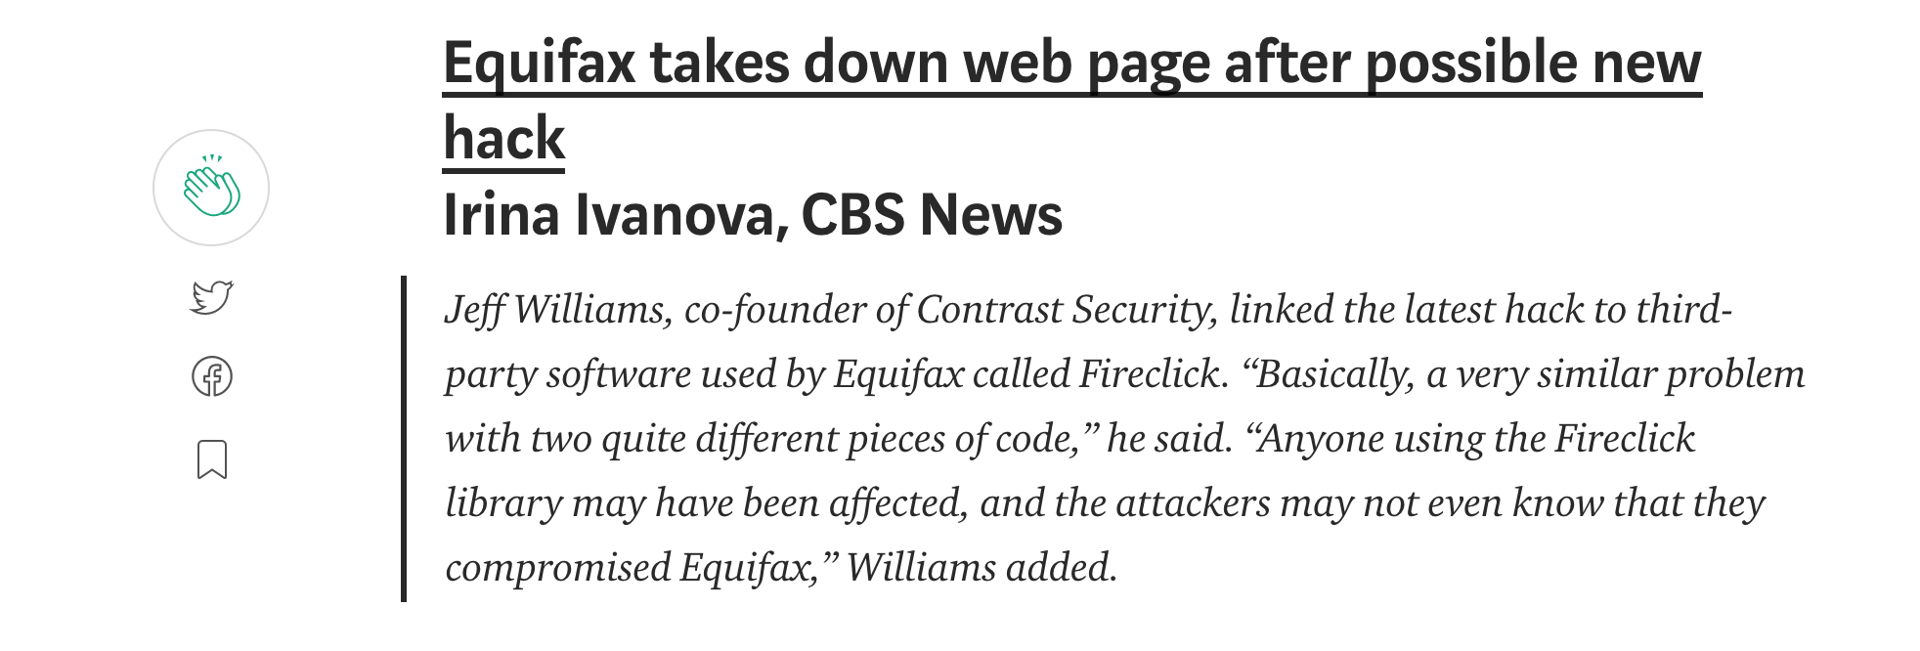
How a third-party software/library affected Equifax’s business !!!
Notes:
Consumer credit score company Equifax has revealed that hackers accessed up to 143 million customer account details earlier this year. The data breach happened on July 29 and the details taken include names, social security numbers, drivers licences, and credit card numbers of around 200,000 people.
Company CEO Richard Smith said a vulnerability in its website allowed the information to be accessed and that those who wanted to check if they had been affected needed to provide their last name and the last six digits of their social security number. People in the UK have also been affected by the data breach but the company has not revealed how many. "This is clearly a disappointing event for our company, and one that strikes at the heart of who we are and what we do," Smith said in a statement.

Slide 23


Quick reference to check third-party libraries vulnerabilities
To check it now !!!
Update Libraries & Components to overcome known vulnerabilities!
Notes:
OpenSSL cryptographic software library has a memory leak bug
Reuters, one of the biggest news agency got hacked because of vulnerable version of WordPress
As a QA We should ensure we apply all security patches on time and also understand if it will impact our project by thorough testing.

Slide 24
Session Management
Notes:
Access someone else’s basket:
Navigate to basket from any other page,intercept this request and notice the get part of the request.
It has an user id- modify it to a different id.

Slide 25
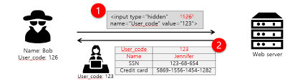
Ensure there is no scope for data tampering
Implement ideal session time-outs.
Ensure the regenerated session identifiers are sufficiently random.
Destroy session at the sign of tampering
Set attributes to the cookies Secure,HttpOnly, Expire
URL MANIPULATION
http://bankingsite.com?sessionID=AKH078WSD4RTH125
http://bankingsite.com/verify?userid=9898989

Slide 26
Disclaimer
Hacking is illegal and should not be performed.
Security testing is an agreed form of audit between two parties and should be in bound in writing defining the scope and nature of what is to be audited
Notes:
Q & A
Slide 8: What are the components/segments that are vulnerable?
Slide 10: List a few defense mechanisms?
Slide 13: How can we ensure Authentication mechanisms adopted are no longer vulnerable?
Slide 14: How does Talisman help us?
Slide 16: When we mention Authorization what practices come to your mind?
Slide 19: Why and when should we opt for HTTPS and not HTTP?
Slide 21: Primary differences between whitelisting and blacklisting?
Slide 21: Why is Input validation important?
Slide 23: “Stay-up-to-date”, what was the logic behind that statement?
Slide 25: What are the practices for effective session management?

Slide 27
References
OWASP: https://www.owasp.org/images/0/08/OWASP_SCP_Quick_Reference_Guide_v2.pdf
GitCrypt: https://github.com/AGWA/git-crypt
Talisman: https://github.com/thoughtworks/talisman
HTTPS: https://www.quicksprout.com/2016/03/25/should-you-switch-your-site-to-https-heres-why-you-should-or-shouldnt/
Two factor authentication: https://www.securenvoy.com/two-factor-authentication/what-is-2fa.shtm
Open Source Security Testing Tools: http://www.cigniti.com/blog/8-open-source-security-testing-tools-to-test-your-website/
Check account has been hacked https://haveibeenpwned.com/

Slide 28
Thank You

